Slide 1

CMR TECHNICAL CAMPUS Accredited by NBA, Approved by AICTE, affiliated to JNTUH Kandlakoya (v), Medchal Road, Hyderabad-501401
ANDROID APPLICATION: MyNotes APP
Under Guidance
B. Ramji
(Assistant Professor)
Team Members
Ankit Palahania (177R1A05K2)
K. Shravya (177R1A05L4)
Lingala Achyuth Reddy (177R1A05L5)

Slide 2
Contents
Abstract
Existing Systems
Disadvantages
Proposed Systems
Advantages
Requirements
Architecture
UML Diagrams
Sample code
Screenshots
Conclusion
Future Enhancement

Slide 3
Abstract
Android is an open and free operating system based on Linux, which is mainly used for mobile terminals, such as smartphones and panel computers.
The android apps which are present in the phone are of apk format(android package kit) which are compiled with Android Studio.
Here we used Android Studio as it is the official integrated development environment for Google's Android operating system, built on JetBrains IntelliJ IDEA software and designed specifically for Android development.
Our approach here is to create an android notes app named as “MyNotes” in which a user can create day to day notes and can attach links and photos so that the user can work productively.
The app interface is based on dark theme which enhances the user interface and makes the app very minimalist and user interactive. And provides very snappy and seamless experience.

Slide 4
Existing System
The existing applications are good enough but sometimes they are not supported in all devices and some takes huge storage space due to which sometimes it becomes harder for users to use these apps efficiently.
There are many notes app which requires Gmail or other accounts then only the user can use these apps which make the app prohibited for the user base that don’t have any Gmail accounts.
Some apps are very basic and don’t have extra features and good user interface while some apps are very complex to use.
Hence our app will overcome these small issues effectively by writing easy and less complex algorithms.

Slide 5
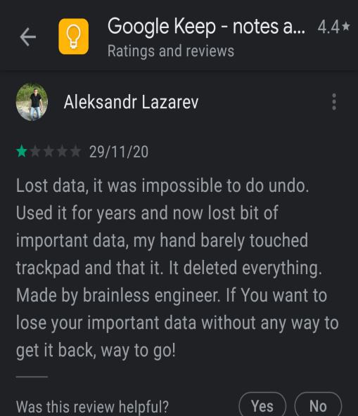
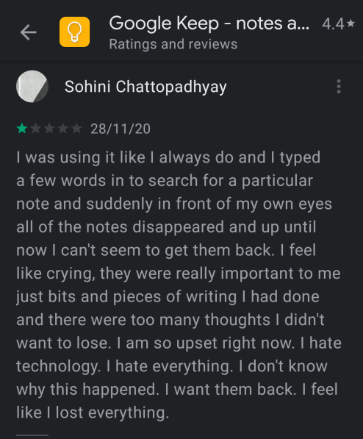
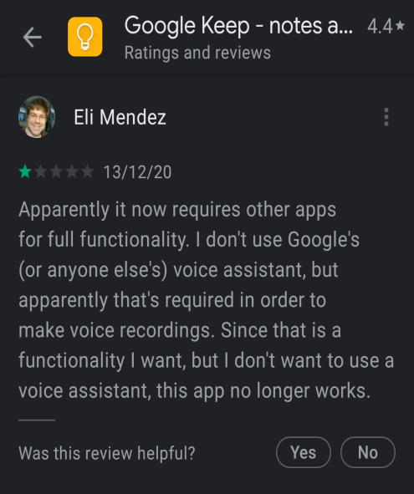
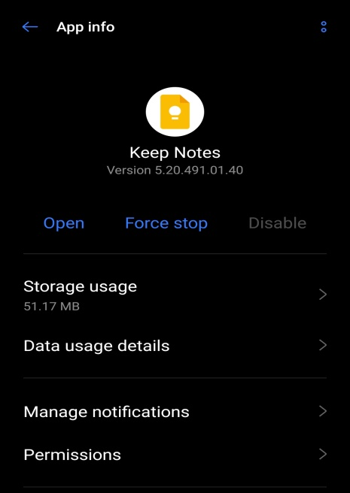
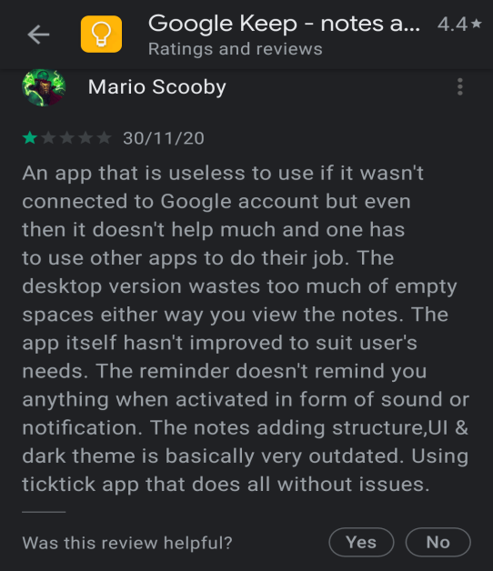
Disadvantages
There are cases where these apps use unknown sources of the databases to store the information of user’s account due to which the privacy is compromised sometimes.
Some apps consume more ram and power due to their large size and complex algorithms and sometimes need internet connectivity for working properly.
Generally there are some cases when apps requires Gmail / Facebook / any other platform account to login into the app due to this many users who don’t have the accounts on these platform are unable to use these types of apps.
Unexpected bugs are encountered sometimes to the users which makes the user experience worst. And some large notes apps works ineficiently for low end devices.

Slide 6
Proposed System
In this project, we are creating an android application named as “MyNotes” which is basically used for taking notes in mobile.
In this app a user can take notes in textual format, can pin images for better understanding of notes and can attach some links as well so that the notes will become clean, efficient and easy to use.
This app focuses on all types of user base who are more focused on productivity and uses there mobile device more frequently.
The minimal look and dark theme of this app along with easy to use user interface enables user to use this app efficiently and effectively.
This app uses less complex algorithms due to which this app takes very less space, works faster and RAM usage is also minimized.
Here privacy of the users is highly maintained as we use ROOM database layer (provided by Google) on top of SQLlite database to store the notes of users in persistence database and also there is no need to login in any platform to use this app.
So basically it overcomes the issue of existing apps and provides a very minimal and interactive user experience to the users.
Hence this app can be used by every user in their daily life to take down their basic commitments, plans, list of items, things to do, daily notes or any other tasks in this app.

Slide 7
Advantages
Minimal and dark theme makes the user interface of the app very refreshing and interactive.
User can use this app daily to take down daily tasks, notes, commitments, thing to do, list of items or any other daily tasks.
Whenever we save our note the time of creating that note is also saved so that user will be able to know when the notes was created and for what use it was created.
Suitable to every user who uses their android mobile devices frequently and takes down their notes in their devices. Hence for them this can be good alternative.
Small in size(9 MB only), hence power and RAM consumption is very less.
HIGHLY secure in database storage(data is stored in local persistence storage) as no third party storage is used here. No internet connectivity is required as well
Since no login is required to use this app, the data privacy is maintained transparently using ROOM database.
Seamless experience and snappy experience. Works very fast in every version of android device (from low end device Android version 6.0 to High end Device Android version 11.0).

Slide 8
Hardware Requirements
For developing the application, the following are the Hardware Requirements:
PROCESSOR: minimum Intel i3 (5th gen) clocked@2.90GHz.
SPACE ON HARD DISK: minimum 2GB space.
RAM: minimum 4GB

Slide 9
Software Requirements
Operating Systems supported:
Windows 7, 8 and 10
Technologies and Languages Used:
Java and XML
Android Studio (IDE)
Adobe XD (For Icon Designing)

Slide 10
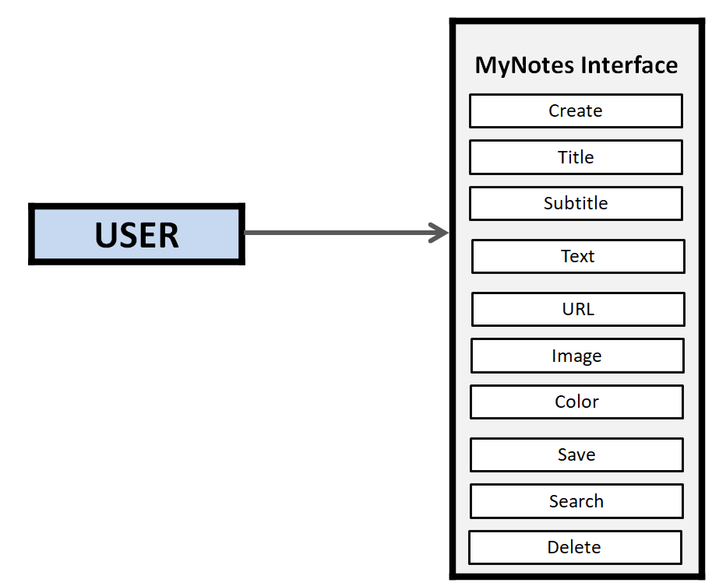
Architecture
Fig: User interacting with the MyNotes Android Application

Slide 11
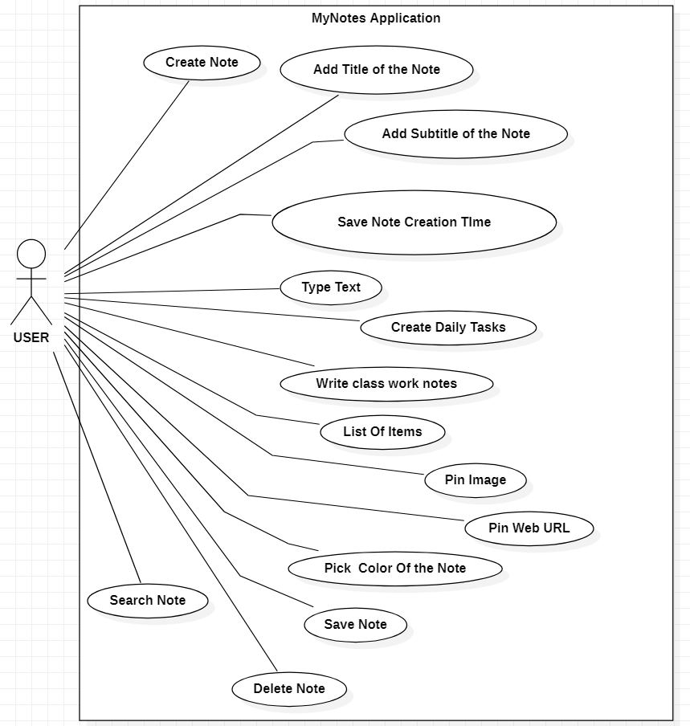
UML Diagrams : 1) Use Case Diagram

Slide 12
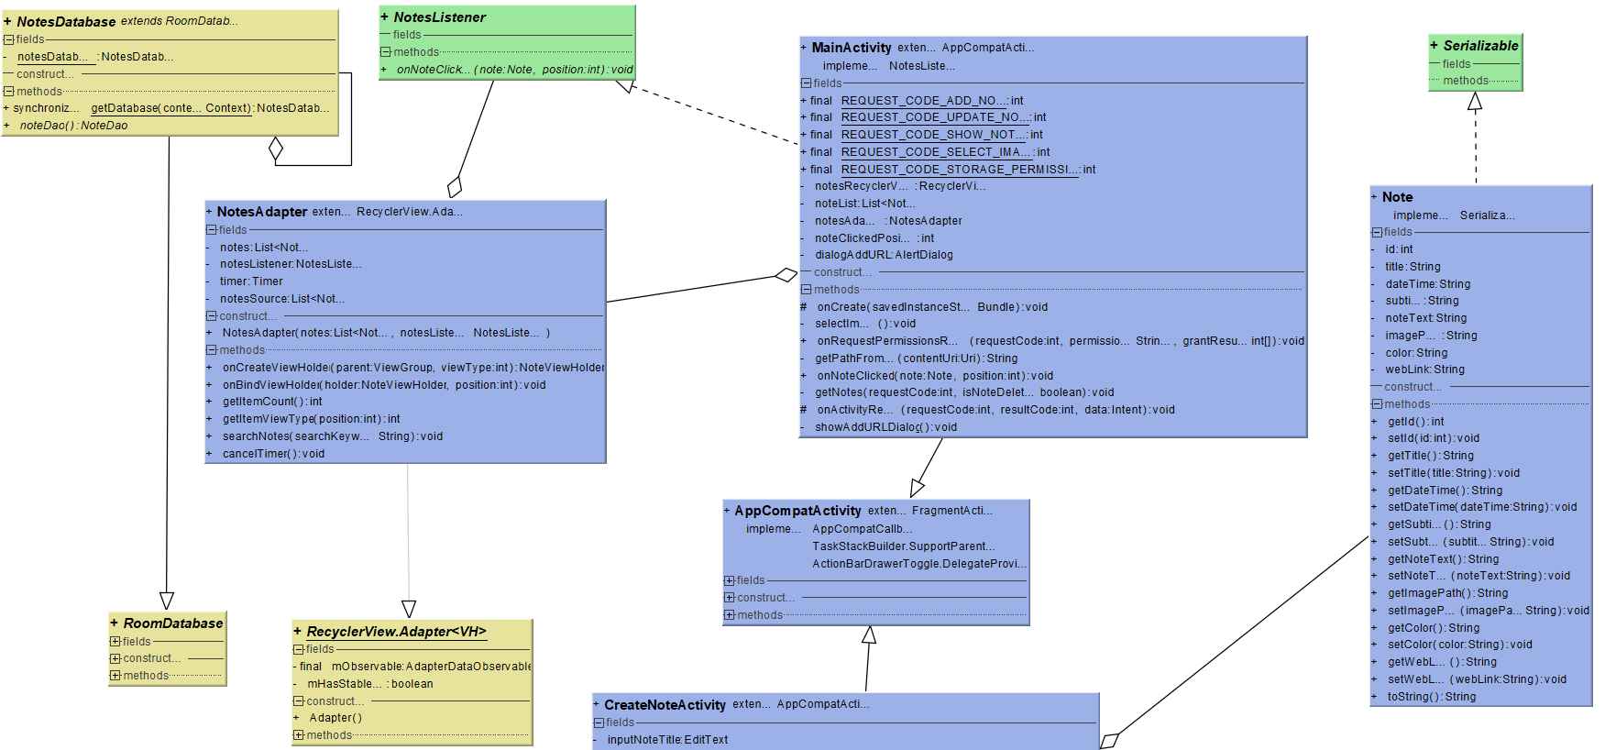
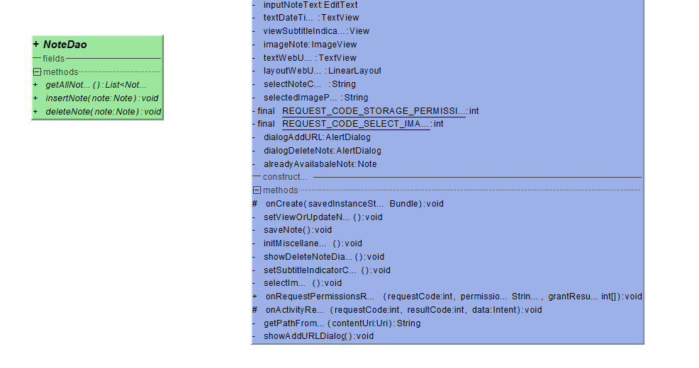
2) Class Diagram

Slide 13
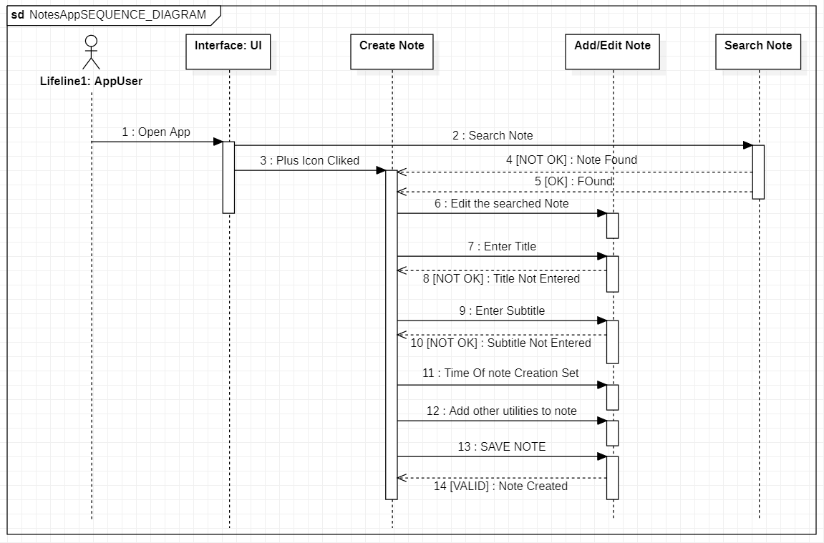
3) SEQUENCE DIAGRAM

Slide 14
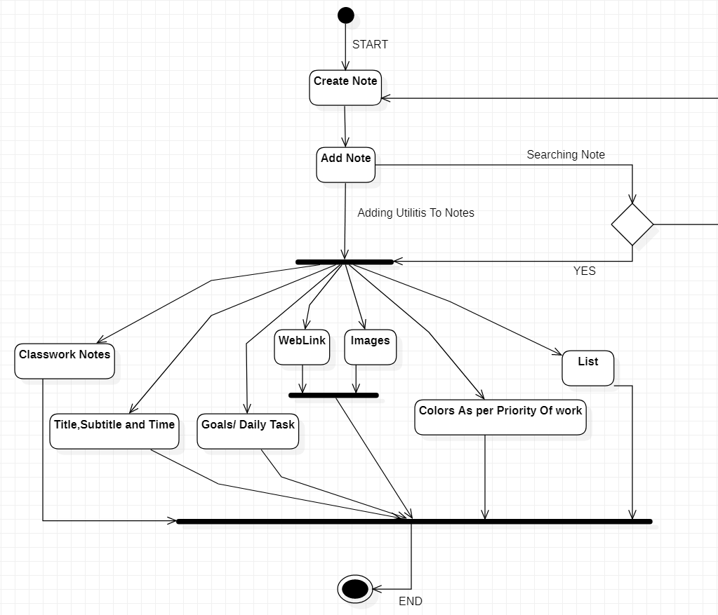
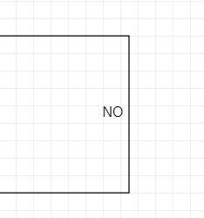
4) ACTIVITY DIAGRAM

Slide 15
Sample Code : 1) MainActivity.java
import android.Manifest;
import android.annotation.SuppressLint;
import android.content.Intent;
import android.content.pm.PackageManager;
import android.database.Cursor;
import android.graphics.drawable.ColorDrawable;
import android.provider.MediaStore;
import android.text.Editable;
import android.text.TextWatcher;
import android.util.Patterns;
import android.view.LayoutInflater;
import android.view.View;
import android.view.ViewGroup;
import android.widget.EditText;
import android.widget.ImageView;
import android.widget.Toast;
import com.example.cleannotes.R;
import com.example.cleannotes.adapters.NotesAdapter;
import com.example.cleannotes.database.NotesDatabase;
import com.example.cleannotes.entities.Note;
import com.example.cleannotes.listeners.NotesListener;
import java.util.ArrayList;
import java.util.List;

Slide 16
public class MainActivity extends AppCompatActivity implements NotesListener
{
public static final int REQUEST_CODE_ADD_NOTE=1; //USED TO ADD A NOTE
public static final int REQUEST_CODE_UPDATE_NOTE=2; //USED TO UPDATE THE NOTE
public static final int REQUEST_CODE_SHOW_NOTES =3; //USED TO DISPLAY ALL NOTES
public static final int REQUEST_CODE_SELECT_IMAGE =4;
public static final int REQUEST_CODE_STORAGE_PERMISSION=5;
private RecyclerView notesRecyclerView;
private List<Note> noteList;
private NotesAdapter notesAdapter;
private int noteClickedPosition = -1;
private AlertDialog dialogAddURL;
@Override
protected void onCreate(@Nullable Bundle savedInstanceState) {
super.onCreate(savedInstanceState);
setContentView(R.layout.activity_main);
ImageView imageAddNoteMain = findViewById(R.id.imageAddNoteMain);
imageAddNoteMain.setOnClickListener(new View.OnClickListener() {
@Override
public void onClick(View view) {
startActivityForResult(
new Intent(getApplicationContext(), CreateNoteActivity.class), REQUEST_CODE_ADD_NOTE
);
}
});
notesRecyclerView = findViewById(R.id.notesRecyclerView);
notesRecyclerView.setLayoutManager(
new StaggeredGridLayoutManager(2,StaggeredGridLayoutManager.VERTICAL)
);

Slide 17
noteList = new ArrayList<>();
notesAdapter = new NotesAdapter(noteList, this);
notesRecyclerView.setAdapter(notesAdapter);
getNotes(REQUEST_CODE_SHOW_NOTES, false);
EditText inputSearch = findViewById(R.id.inputSearch);
inputSearch.addTextChangedListener(new TextWatcher() {
@Override
public void beforeTextChanged(CharSequence s, int start, int count, int after) {
}
@Override
public void onTextChanged(CharSequence s, int start, int before, int count) {
notesAdapter.cancelTimer();
}
@Override
public void afterTextChanged(Editable s) {
if(noteList.size()!=0)
{
notesAdapter.searchNotes(s.toString());
}
}
});
findViewById(R.id.imageAddNote).setOnClickListener(new View.OnClickListener() {
@Override
public void onClick(View v) {
startActivityForResult(
new Intent(getApplicationContext(), CreateNoteActivity.class), REQUEST_CODE_ADD_NOTE
);
}
});

Slide 18
findViewById(R.id.imageAddImage).setOnClickListener(new View.OnClickListener() {
@Override
public void onClick(View v) {
if(ContextCompat.checkSelfPermission(
getApplicationContext() , Manifest.permission.READ_EXTERNAL_STORAGE
) != PackageManager.PERMISSION_GRANTED)
{
ActivityCompat.requestPermissions(
MainActivity.this,
new String[] {Manifest.permission.READ_EXTERNAL_STORAGE},
REQUEST_CODE_STORAGE_PERMISSION
);
}
else
{
selectImage();
}
}
});
findViewById(R.id.imageAddWebLink).setOnClickListener(new View.OnClickListener() {
@Override
public void onClick(View v) {
showAddURLDialog();
}
});
}
private void selectImage()
{
Intent intent=new Intent(Intent.ACTION_PICK, MediaStore.Images.Media.EXTERNAL_CONTENT_URI);
if(intent.resolveActivity(getPackageManager())!=null)
{
startActivityForResult(intent,REQUEST_CODE_SELECT_IMAGE);
}
}

Slide 19
@Override
public void onRequestPermissionsResult(int requestCode, @NonNull String[] permissions, @NonNull int[] grantResults) {
super.onRequestPermissionsResult(requestCode, permissions, grantResults);
if(requestCode == REQUEST_CODE_STORAGE_PERMISSION && grantResults.length > 0)
{
if(grantResults[0] == PackageManager.PERMISSION_GRANTED)
{
selectImage();
}
else
{
Toast.makeText(this,"Permission Denied",Toast.LENGTH_SHORT).show();
}
}
}
private String getPathFromUri(Uri contentUri)
{
String filePath;
Cursor cursor=getContentResolver()
.query(contentUri,null,null,null,null);
if(cursor == null)
{
filePath = contentUri.getPath();
}
else
{
cursor.moveToFirst();
int index= cursor.getColumnIndex("_data");
filePath = cursor.getString(index);
cursor.close();
}
return filePath;
}

Slide 20
@Override
public void onNoteClicked(Note note, int position)
{
noteClickedPosition = position;
Intent intent= new Intent(getApplicationContext(), CreateNoteActivity.class);
intent.putExtra("isViewOrUpdate",true);
intent.putExtra("note",note);
startActivityForResult(intent,REQUEST_CODE_UPDATE_NOTE);
}
private void getNotes(final int requestCode, final boolean isNoteDeleted)
{
@SuppressLint("StaticFieldLeak")
class GetNotesTask extends AsyncTask<Void, Void, List<Note>>
{
@Override
protected List<Note> doInBackground(Void... voids) {
return NotesDatabase.getDatabase(getApplicationContext()).noteDao().getAllNotes();
}
@Override
protected void onPostExecute(List<Note> notes) {
super.onPostExecute(notes);
if(requestCode == REQUEST_CODE_SHOW_NOTES)
{
noteList.addAll(notes);
notesAdapter.notifyDataSetChanged();
}

Slide 21
else if(requestCode == REQUEST_CODE_ADD_NOTE)
{
noteList.add(0,notes.get(0));
notesAdapter.notifyItemInserted(0);
notesRecyclerView.smoothScrollToPosition(0);
}
else if(requestCode == REQUEST_CODE_UPDATE_NOTE)
{
noteList.remove(noteClickedPosition);
if(isNoteDeleted)
{
notesAdapter.notifyItemRemoved(noteClickedPosition);
}
else
{
noteList.add(noteClickedPosition,notes.get(noteClickedPosition));
notesAdapter.notifyItemChanged(noteClickedPosition);
}
}
}
}
new GetNotesTask().execute();
}

Slide 22
@Override
protected void onActivityResult(int requestCode, int resultCode, @Nullable Intent data) {
super.onActivityResult(requestCode, resultCode, data);
if(requestCode == REQUEST_CODE_ADD_NOTE && resultCode == RESULT_OK)
{
getNotes(REQUEST_CODE_ADD_NOTE, false);
}
else if(requestCode == REQUEST_CODE_UPDATE_NOTE && resultCode == RESULT_OK)
{
if(data != null)
{
getNotes(REQUEST_CODE_UPDATE_NOTE,data.getBooleanExtra("isNoteDeleted",false));
}
}
else if(requestCode == REQUEST_CODE_SELECT_IMAGE && resultCode == RESULT_OK)
{
if(data != null)
{
Uri selectedImageUri = data.getData();
if(selectedImageUri !=null)
{
try {
String selectedImagePath = getPathFromUri(selectedImageUri);
Intent intent = new Intent(getApplicationContext(), CreateNoteActivity.class);
intent.putExtra("isFromQuickActions",true);
intent.putExtra("quickActionType","image");
intent.putExtra("imagePath",selectedImagePath);
startActivityForResult(intent,REQUEST_CODE_ADD_NOTE);
}
catch ( Exception exception)
{
Toast.makeText(this,exception.getMessage(),Toast.LENGTH_SHORT).show();
}
}
}
}}

Slide 23
private void showAddURLDialog()
{
if(dialogAddURL == null)
{
AlertDialog.Builder builder=new AlertDialog.Builder(MainActivity.this);
View view = LayoutInflater.from(this).inflate(
R.layout.layout_add_url,
(ViewGroup) findViewById(R.id.layoutAddUrlContainer)
);
builder.setView(view);
dialogAddURL = builder.create();
if(dialogAddURL.getWindow() != null)
{
dialogAddURL.getWindow().setBackgroundDrawable(new ColorDrawable(0));
}
final EditText inputURL = view.findViewById(R.id.inputURL);
inputURL.requestFocus();
view.findViewById(R.id.textAdd).setOnClickListener(new View.OnClickListener() {
@Override
public void onClick(View v) {
if(inputURL.getText().toString().trim().isEmpty())
{
Toast.makeText(MainActivity.this,"Enter URL",Toast.LENGTH_SHORT).show();
}
else if(!Patterns.WEB_URL.matcher(inputURL.getText().toString()).matches())
{
Toast.makeText(MainActivity.this,"Enter valid URL",Toast.LENGTH_SHORT).show();
}

Slide 24
else
{
dialogAddURL.dismiss();
Intent intent = new Intent(getApplicationContext(), CreateNoteActivity.class);
intent.putExtra("isFromQuickActions",true);
intent.putExtra("quickActionType","URL");
intent.putExtra("URL",inputURL.getText().toString());
startActivityForResult(intent,REQUEST_CODE_ADD_NOTE);
}
}
});
view.findViewById(R.id.textCancel).setOnClickListener(new View.OnClickListener() {
@Override
public void onClick(View v) {
dialogAddURL.dismiss();
}
});
}
dialogAddURL.show();
}
}

Slide 25
2) Activity_Main.xml
<?xml version="1.0" encoding="utf-8"?>
<androidx.constraintlayout.widget.ConstraintLayout xmlns:android="http://schemas.android.com/apk/res/android"
xmlns:app="http://schemas.android.com/apk/res-auto"
xmlns:tools="http://schemas.android.com/tools"
android:layout_width="match_parent"
android:layout_height="match_parent"
android:background="@color/colorPrimary"
tools:context=".activities.MainActivity">
<TextView
android:id="@+id/textMyNotes"
android:layout_width="match_parent"
android:layout_height="wrap_content"
android:layout_marginStart="@dimen/_12sdp"
android:layout_marginTop="@dimen/_20sdp"
android:layout_marginEnd="@dimen/_12sdp"
android:fontFamily="@font/ubuntu_bold"
android:includeFontPadding="false"
android:text="@string/my_notes"
android:textColor="@color/colorWhite"
android:textSize="@dimen/_22ssp"
app:layout_constraintTop_toTopOf="parent"
/>

Slide 26
<LinearLayout
android:id="@+id/layoutSearch"
android:layout_width="match_parent"
android:layout_height="wrap_content"
android:layout_marginStart="@dimen/_8sdp"
android:layout_marginTop="@dimen/_15sdp"
android:layout_marginEnd="@dimen/_8sdp"
android:background="@drawable/background_search"
android:gravity="center_vertical"
android:orientation="horizontal"
android:paddingStart="@dimen/_10sdp"
android:paddingEnd="@dimen/_10sdp"
app:layout_constraintTop_toBottomOf="@+id/textMyNotes">
<ImageView
android:layout_width="@dimen/_20sdp"
android:layout_height="@dimen/_20sdp"
android:contentDescription="@string/app_name"
android:src="@drawable/ic_search"
android:tint="@color/colorSearchIcon"/>
<EditText
android:id="@+id/inputSearch"
android:layout_width="match_parent"
android:layout_height="@dimen/_35sdp"
android:layout_marginStart="@dimen/_12sdp"
android:background="@null"
android:fontFamily="@font/ubuntu_regular"
android:hint="Search notes"
android:imeOptions="actionDone"
android:importantForAutofill="no"
android:inputType="text"
android:textColor="@color/colorWhite"
android:textColorHint="@color/colorTextHint"
android:textSize="@dimen/_13ssp"
/>

Slide 27
</LinearLayout>
<androidx.recyclerview.widget.RecyclerView
android:id="@+id/notesRecyclerView"
android:layout_width="match_parent"
android:layout_height="0dp"
android:layout_marginStart="@dimen/_20sdp"
android:layout_marginEnd="@dimen/_2sdp"
android:clipToPadding="false"
android:paddingStart="0dp"
android:paddingEnd="@dimen/_12sdp"
android:paddingBottom="@dimen/_12sdp"
app:layout_constraintBottom_toTopOf="@id/layoutQuickActions"
app:layout_constraintTop_toBottomOf="@id/layoutSearch"
/>
<LinearLayout
android:id="@+id/layoutQuickActions"
android:layout_width="match_parent"
android:layout_height="wrap_content"
android:background="@color/colorQuickActionBackground"
android:gravity="center_vertical"
android:orientation="horizontal"
android:padding="@dimen/_15sdp"
app:layout_constraintBottom_toBottomOf="parent">
<ImageView
android:id="@+id/imageAddNote"
android:layout_width="@dimen/_23sdp"
android:layout_height="@dimen/_23sdp"
android:contentDescription="@string/app_name"
android:src="@drawable/ic_add_outline"
android:tint="@color/colorIcons"
/>

Slide 28
<ImageView
android:id="@+id/imageAddImage"
android:layout_width="@dimen/_23sdp"
android:layout_height="@dimen/_23sdp"
android:layout_marginStart="@dimen/_15sdp"
android:contentDescription="@string/app_name"
android:src="@drawable/ic_image"
android:tint="@color/colorIcons"
/>
<ImageView
android:id="@+id/imageAddWebLink"
android:layout_width="@dimen/_23sdp"
android:layout_height="@dimen/_23sdp"
android:layout_marginStart="@dimen/_15sdp"
android:contentDescription="@string/app_name"
android:src="@drawable/ic_web_link"
android:tint="@color/colorIcons"
/>
</LinearLayout>
<ImageView
android:id="@+id/imageAddNoteMain"
android:layout_width="@dimen/_40sdp"
android:layout_height="@dimen/_40sdp"
android:layout_marginEnd="@dimen/_30sdp"
android:background="@drawable/background_add_button"
android:contentDescription="@string/app_name"
android:padding="@dimen/_5sdp"
android:src="@drawable/ic_add"
android:tint="@color/colorPrimary"
app:layout_constraintBottom_toTopOf="@+id/layoutQuickActions"
app:layout_constraintEnd_toEndOf="parent"
app:layout_constraintTop_toTopOf="@id/layoutQuickActions"
/>
</androidx.constraintlayout.widget.ConstraintLayout>

Slide 29
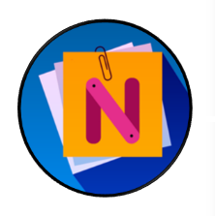
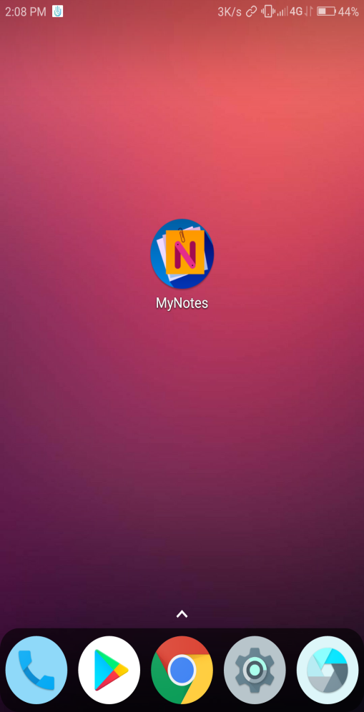
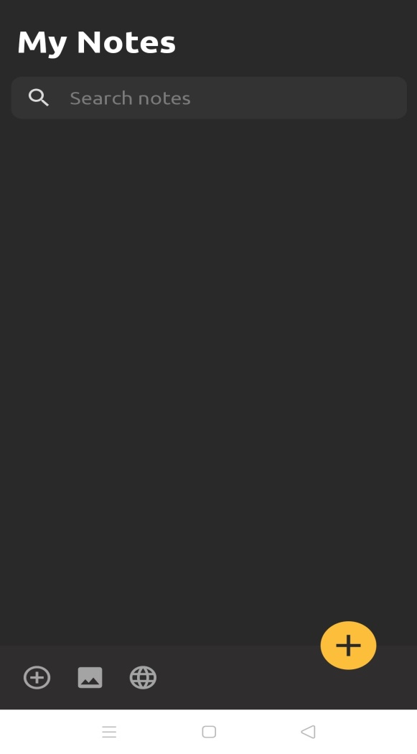
Screenshots
Icon and Home Page

Slide 30
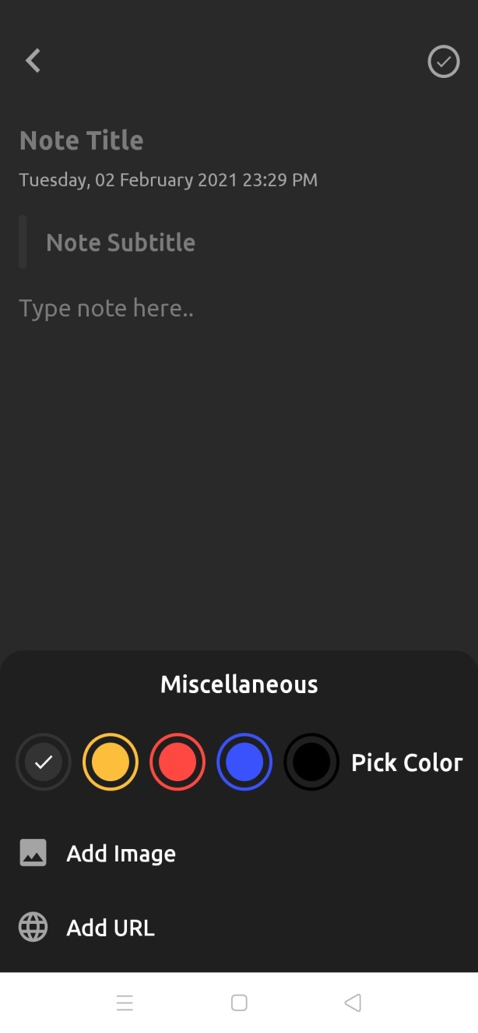
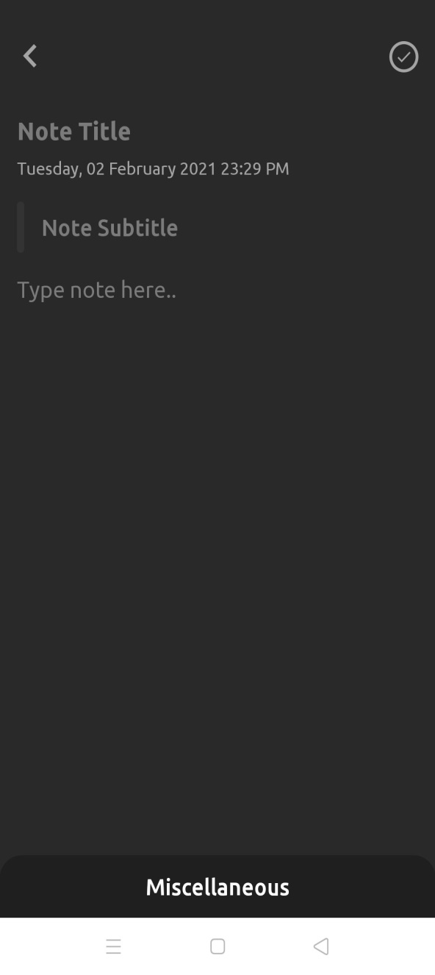
Notes Details Pages: Selecting Color For the Note

Slide 31
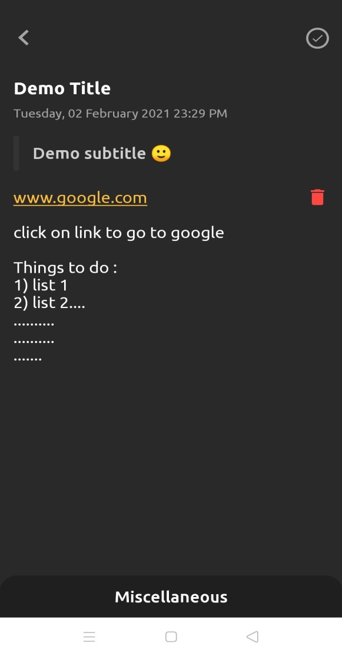
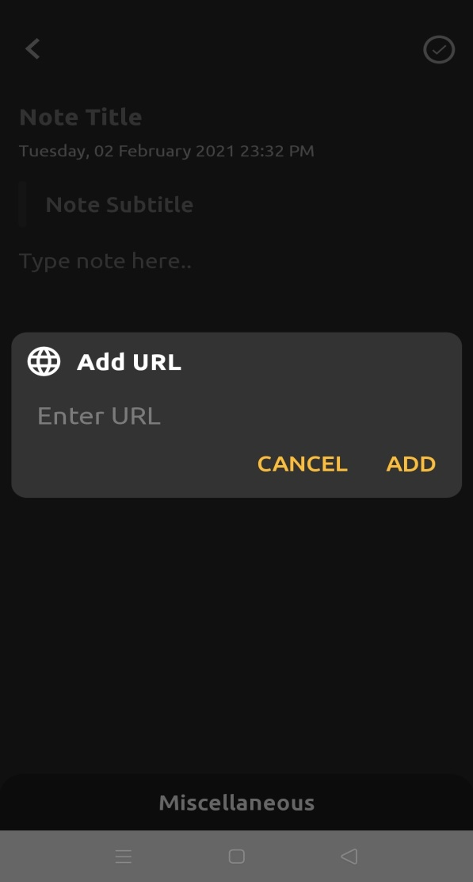
Notes Details Page-2: Adding Text, Emoji and URL to the Note

Slide 32
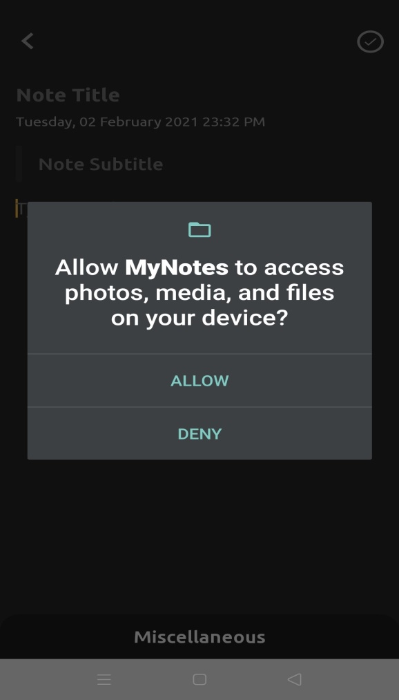
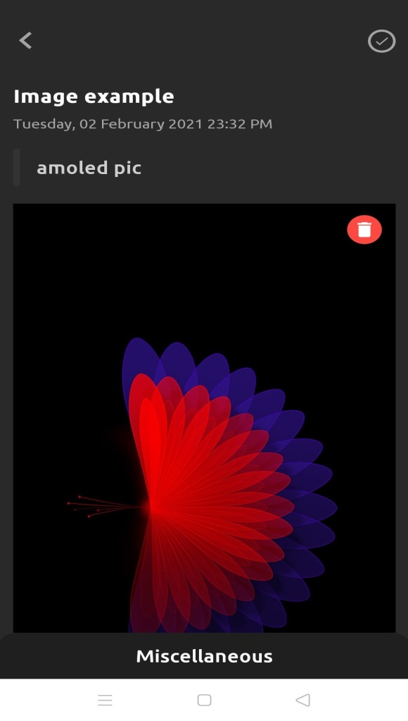
Notes Details Page-3: Accessing Phone media and attaching image

Slide 33
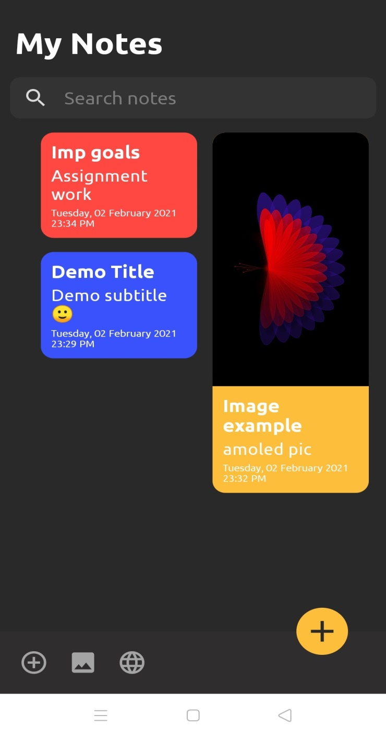
Updated Home Page and Search Bar
We can search any note using its title/subtitle

Slide 34
Conclusion
In this project, we offer an android app for writing down any type of notes, tasks, things to do, daily goals, classwork notes or list of items along with images and links in the mobile device.
This app is very minimal and interactive and hence makes it accessible and easier to use to any kind of user base.
We have tried to make the size of the app very less so that it will not take much space in any mobile. Also the power consumption and RAM consumption is minimized.
This app can be very useful for the students who prefer to take down daily tasks to do or prefer writing the notes on mobile.
Our app is designed for the every kind of user who uses their mobile devices frequently to note down any important things or notes.
Hence, this app works very efficiently with very interactive user interface and privacy of every user is maintained here.

Slide 35
Future Enhancement
Since, this an android application so our future approach is to get the reviews from the users and perform the changes based on them. Thus, in future we can add the features like calendar so that a user can set their goals according to the calendar, we can add reminder so that when the note task is not done it reminds the user about the task. We are further planning to add the share option so that the user can share the work with other users.

Slide 36
THANK YOU

